Slide 1
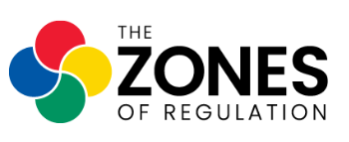
Zones of Regulation
Monday, 6th October 2025

Slide 2
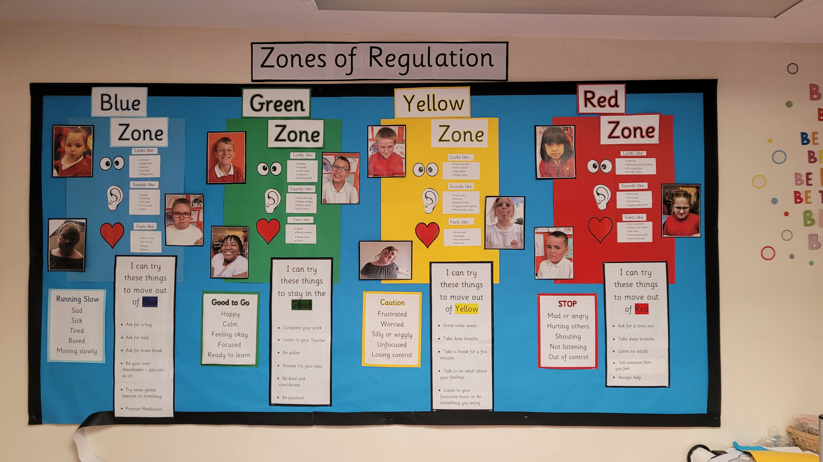
Why Teach Self-Regulation?
Regulation is something everyone continually works on whether we are aware of it or not.
We all encounter trying circumstances that can test our limits.
If we can recognise when we are becoming less regulated, we are able to do something about it to manage our feelings and get ourselves to a healthy place.
This comes more naturally to some, but for others it is a skills that needs more attention and practice .
This is the goal of the Zones of Regulation

Slide 3
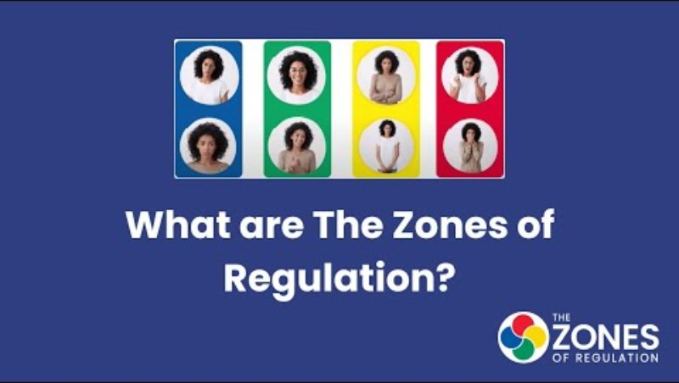
Why Teach Self-Regulation?

Slide 5
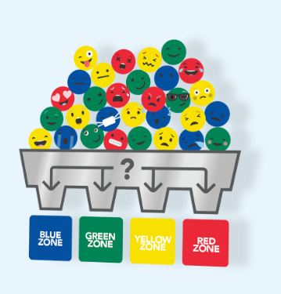
Sorting our emotions into four Zones
Feelings are complicated and come in different sizes, intensities and levels of energy that are unique within our brains and bodies.
To make it easier to talk about, think about and regulate, the Zones of Regulation are organised into four zones:
Blue
Green
Yellow
Red

Slide 6
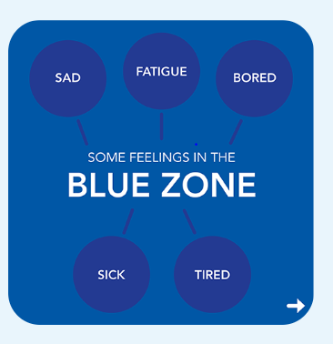
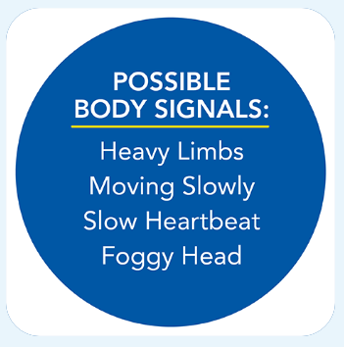
Blue Zone

Slide 7
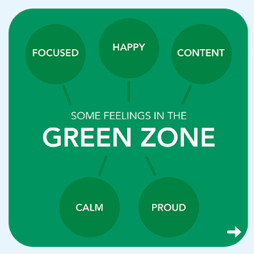
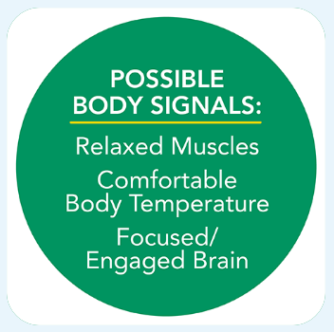
Green Zone

Slide 8
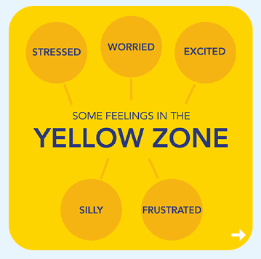
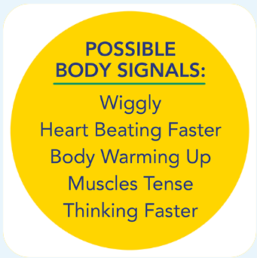
Yellow Zone

Slide 9
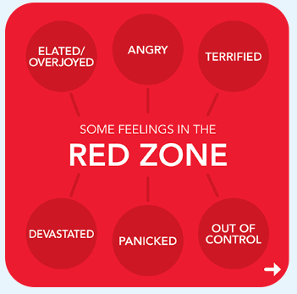
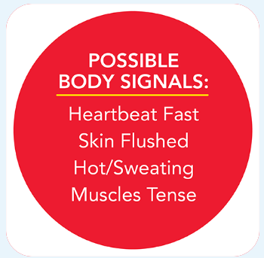
Red Zone

Slide 10
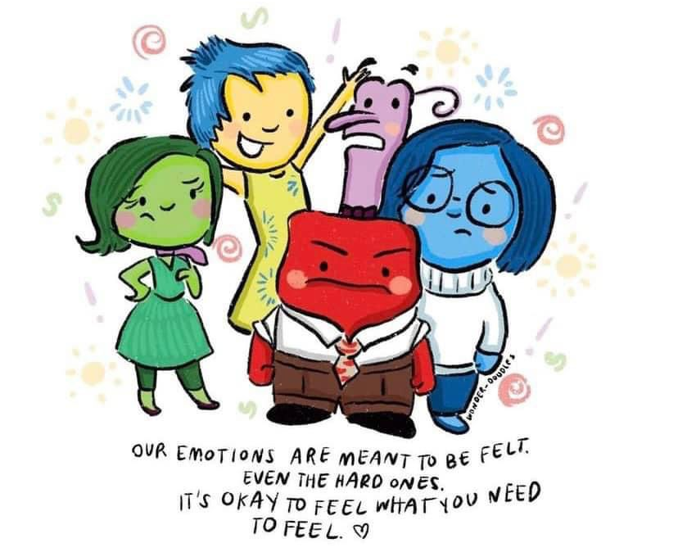
All the Zones are okay

Slide 11
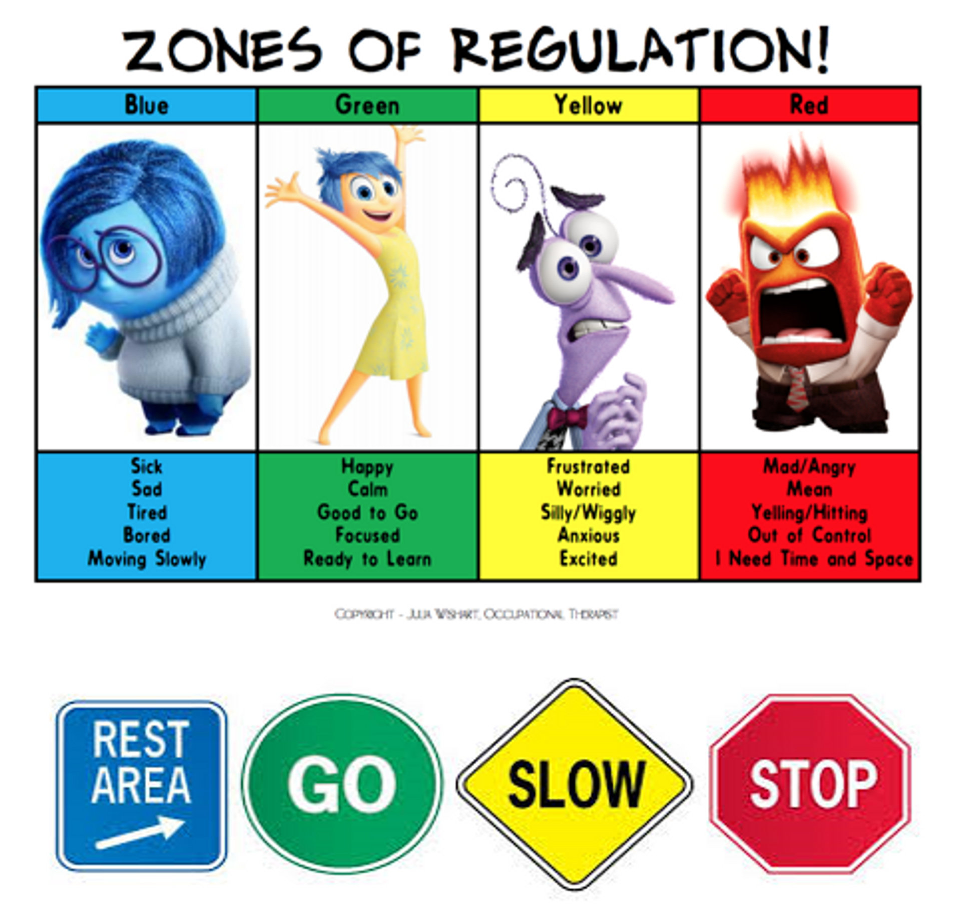
Regulating emotions
Once children are able to recognise what zone they may be in and what emotion they might be feeling, it is important to give them ideas on what to do to regulate those emotions.

Slide 12
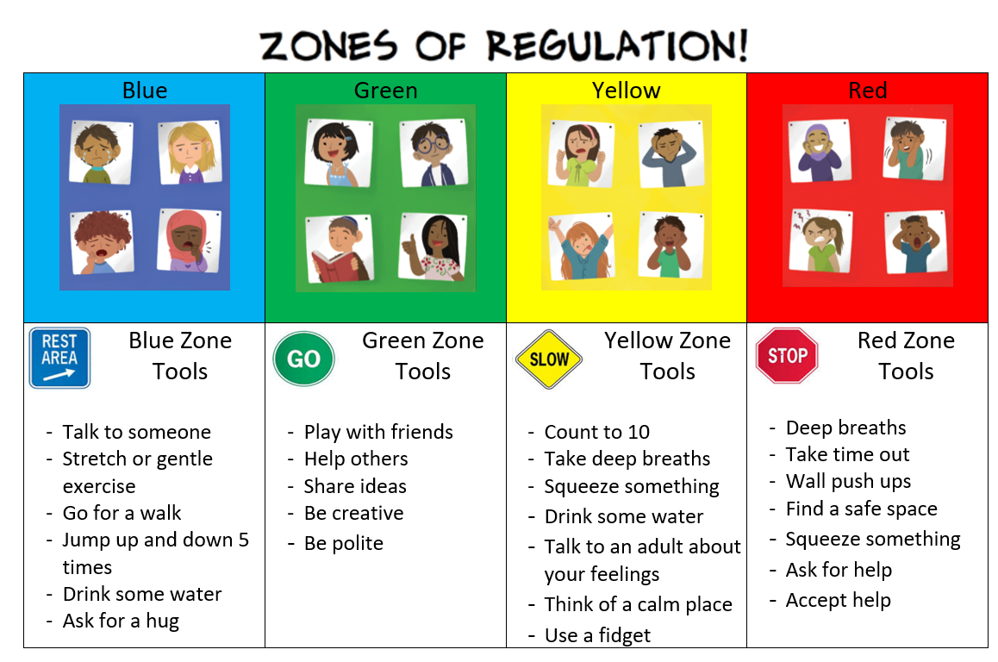
The Toolkit

Slide 13
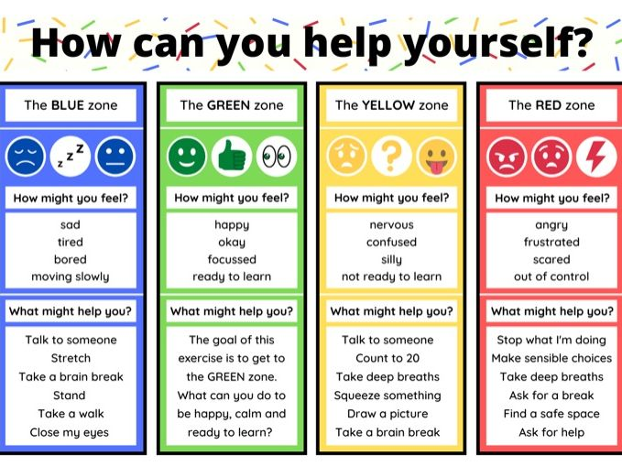
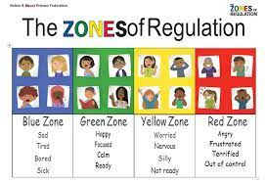
Examples

Slide 14
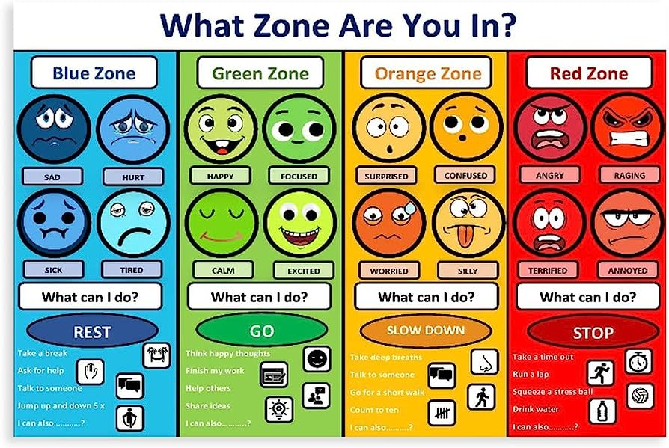
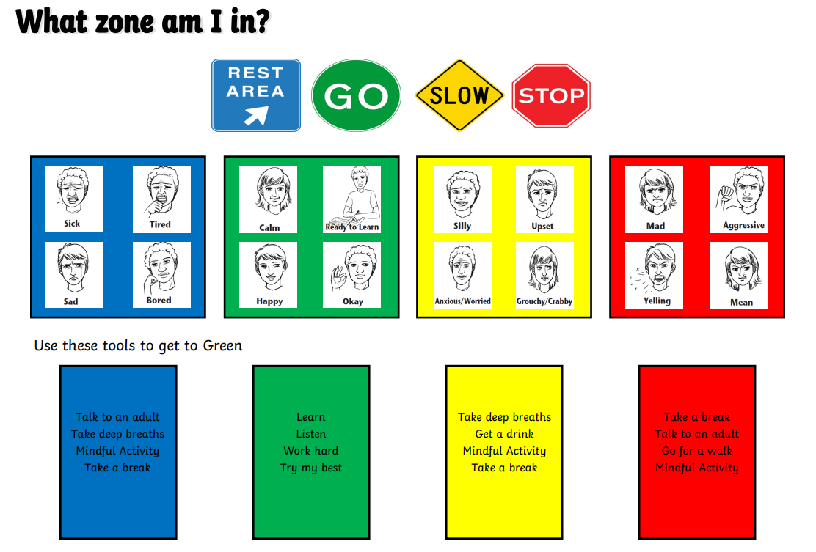
Examples

Slide 15
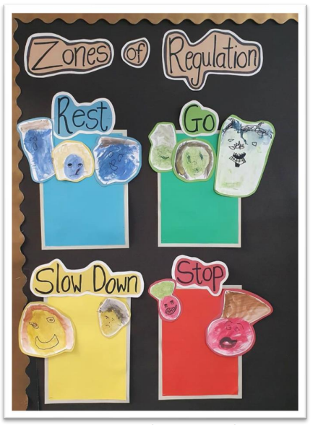
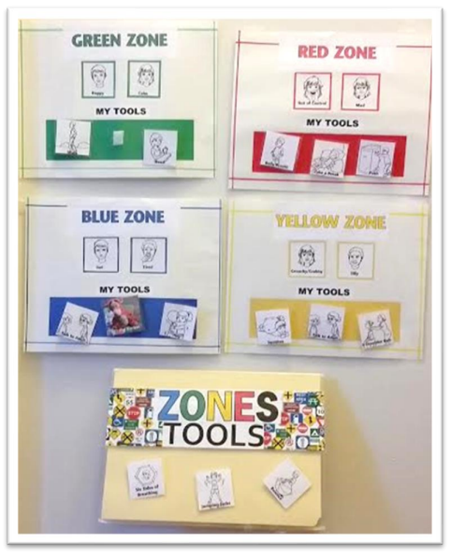
Examples

Slide 16
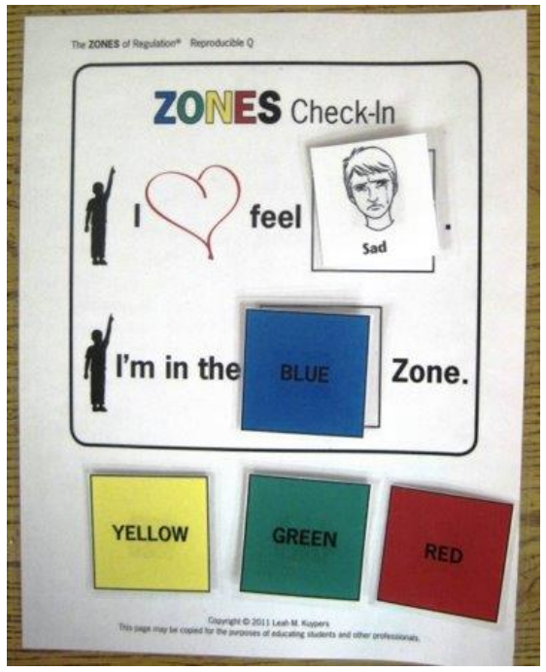
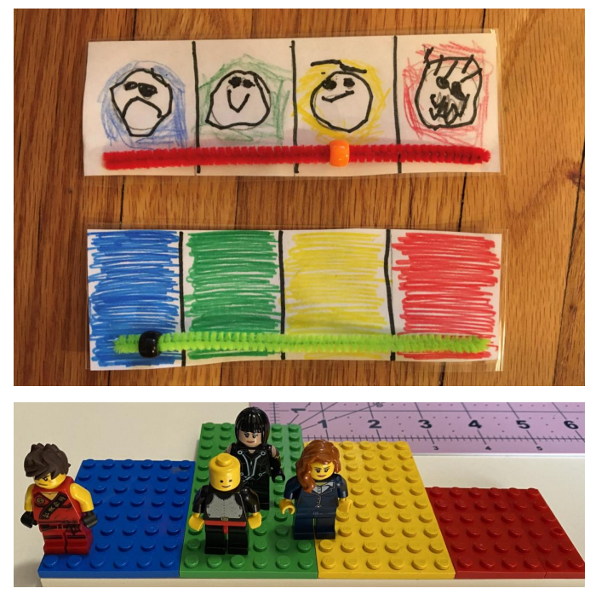
Check Ins

Slide 17
How can you help your child use the zones of regulation at home?
Identify your own feelings using Zones language in front of your child (e.g.: I’m frustrated. I think I am in the Yellow Zone.”)
Talk about what tool you will use to be in the appropriate Zone (e.g.: “I need to take four deep breaths to help get me back to the Green Zone.”)
At times, wonder which Zone your child is in. Or, discuss which Zone a character in a film / book might be in. (e.g.: “You look sleepy. Are you in the Blue Zone?”)
Engage your child in discussion around Zones when they are in the Red Zone is unlikely to be effective. You need to be discussing the different Zones and tools they can use when they are more regulated / calm.
Teach your child which tools they can you. (eg: “It’s time for bed. Let’s read a book together in the comfy chair to get you in the Blue Zone.”)
Regular Check-ins. “How are you feeling now?”

Slide 18
How can you help your child use the zones of regulation at home?
Modelling - It is important to remember to show the children how you use tools to help regulate. You might say “I am going to make myself a cup of tea and do some breathing exercises because I am in the blue zone” and afterwards tell your child how using those tools helped you get back to the green zone.
Share how their behaviour is affecting your Zone. For example, if they are in the Green Zone, you could comment that their behaviour is also helping you feel happy / go into the Green Zone.
Put up and reference the Zones visuals and tools in your home.
Praise and encourage your child when they share which Zone they are in.

Slide 19
Tips for Practicing the Zones of Regulation
Know yourself and how you react in difficult situations before dealing with your child’s behaviours.
Know your child’s sensory threshold. We all process sensory information differently and it impacts our reactivity to situations.
Know your child’s triggers.
Be consistent in managing your child’s behaviour and use the same language you use at home.
Empathise with your child and validate what they are feeling.
Have clear boundaries/routines and always follow through.

Slide 20
Tips for Practicing the Zones of Regulation
Discuss strategies for the next time when you are in a similar situation.
Remember to ask your child how their choices made you feel (empathy).
Praise your child for using strategies. Encourage your child to take a sensory break to help regulate their bodies.
Create a ‘calm’ box full of things which help to keep your child calm and alert.

